Slide 1

School District Network
Team Red Bull
Danny Cruz
Matthew Dawson
Santiago Demaree
Dustin Travis Downing
Anthony Prejean
Michael Lee Van Cleave

Slide 2
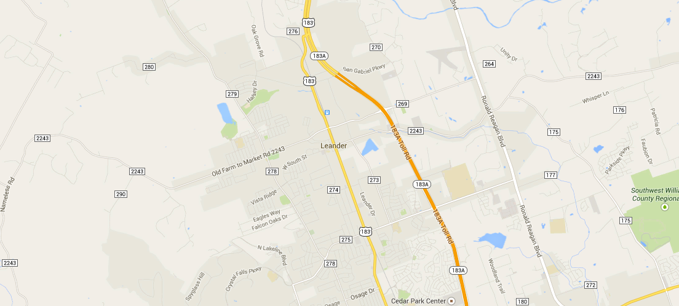
School District Network
Introduction
Our network was designed for a new school district in a growing community.

Slide 3
School District Network
Requirements
Minimize total cost of ownership
Total cost of acquisition vs operating costs
Minimize incoming bandwidth usage
Redundant network lines to every school
District requirements:
1:20 teacher:students
1:100 administrators:students
1:2 high school:middle schools
1:3 middle school:elementary schools

Slide 4
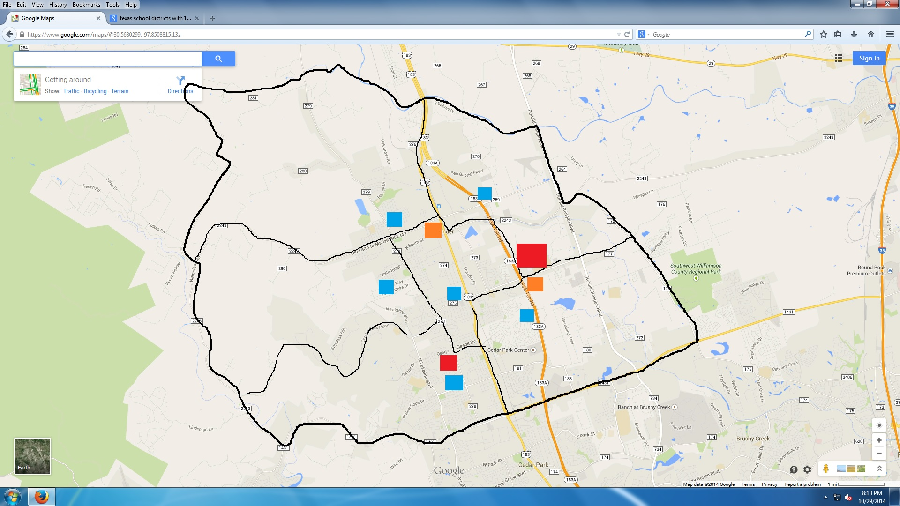
School District Network
Map (zoning and schools)
The growth of the community can be attributed to the new 183A toll road. This construction will also aid in the installation of new fiber.

Slide 5

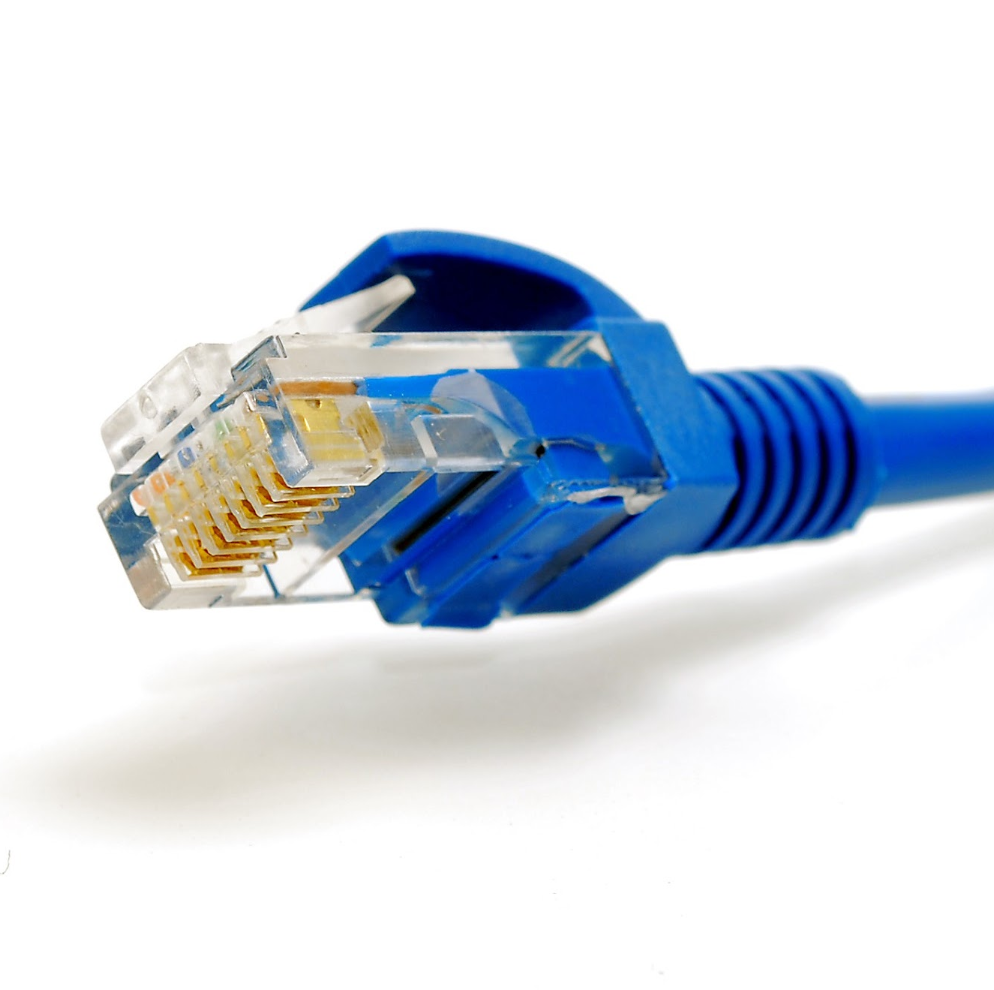
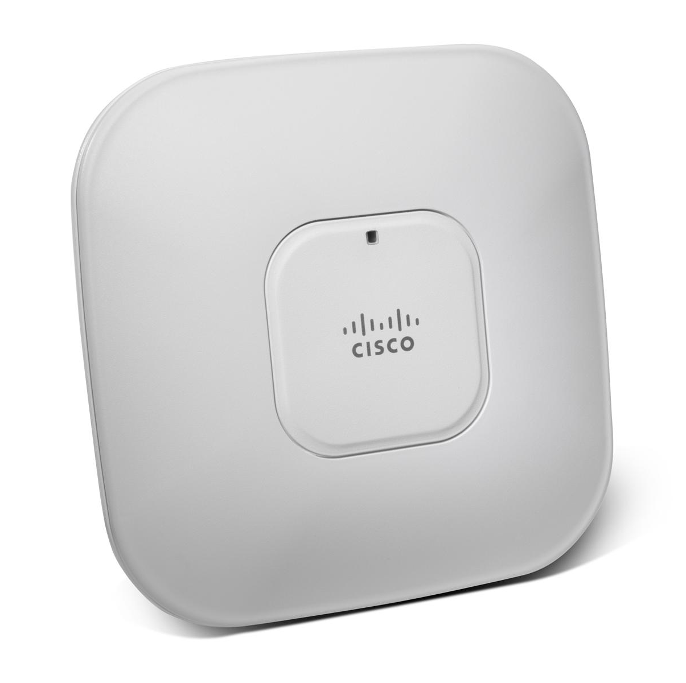
School District Network
Types of Communication
Fiber
Copper
Wireless

Slide 6
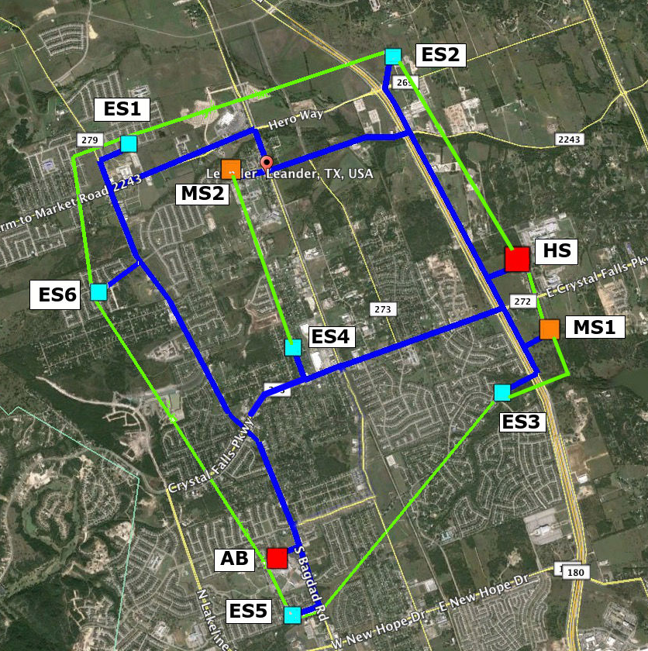
School District Network
Map (with fiber and schools)
Red buildings are the High School (HS) and the Administration Building (AB)
Orange buildings are the Middle Schools (MS1, MS2)
Teal buildings are the Elementary Schools (ES1 - ES6)
Blue lines are the Single Mode Fiber lines
Notes:
This design gives the district the redundancy at each school that they need.

Slide 7
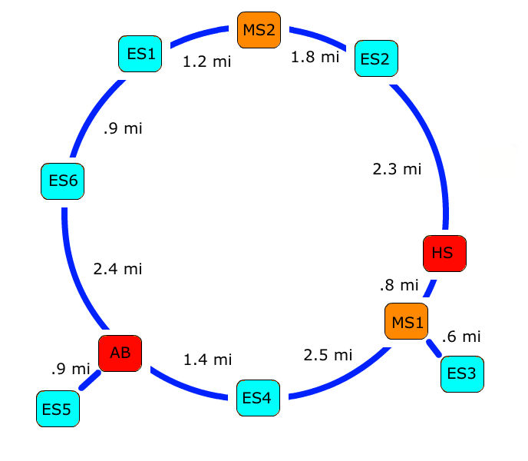
School District Network
Hybrid Ring/Star Topology
Distances between schools
Start | End | Distance
HS | ES2 | 2.3 mi
ES2 | MS2 | 1.8 mi
MS2 | ES1 | 1.2 mi
ES1 | ES6 | 0.9 mi
ES6 | AB | 2.4 mi
AB | ES4 | 1.4 mi
ES4 | MS1 | 2.5 mi
MS1 | HS | 0.8 mi
Total |  | 13.3 mi
Notes:
A ring is the more fault resistant topology but has a high installation cost. Making it the perfect choice for our clients needs. This design is also a counter-rotating ring to reduce congestion and because there is no central HUB (the more research I d0 on the ring topology the more I don’t think we need these green lines)

Slide 8
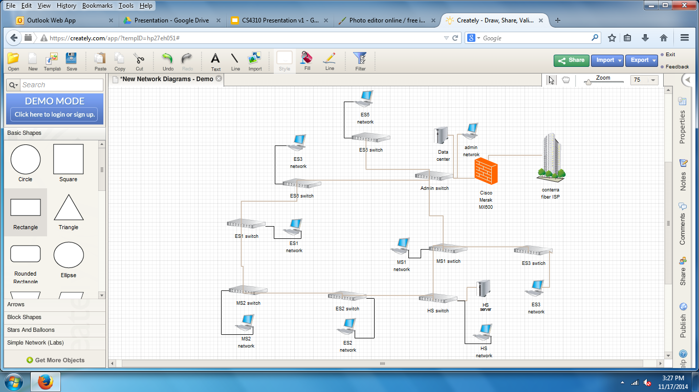
School District Network
District Network Map

Slide 9
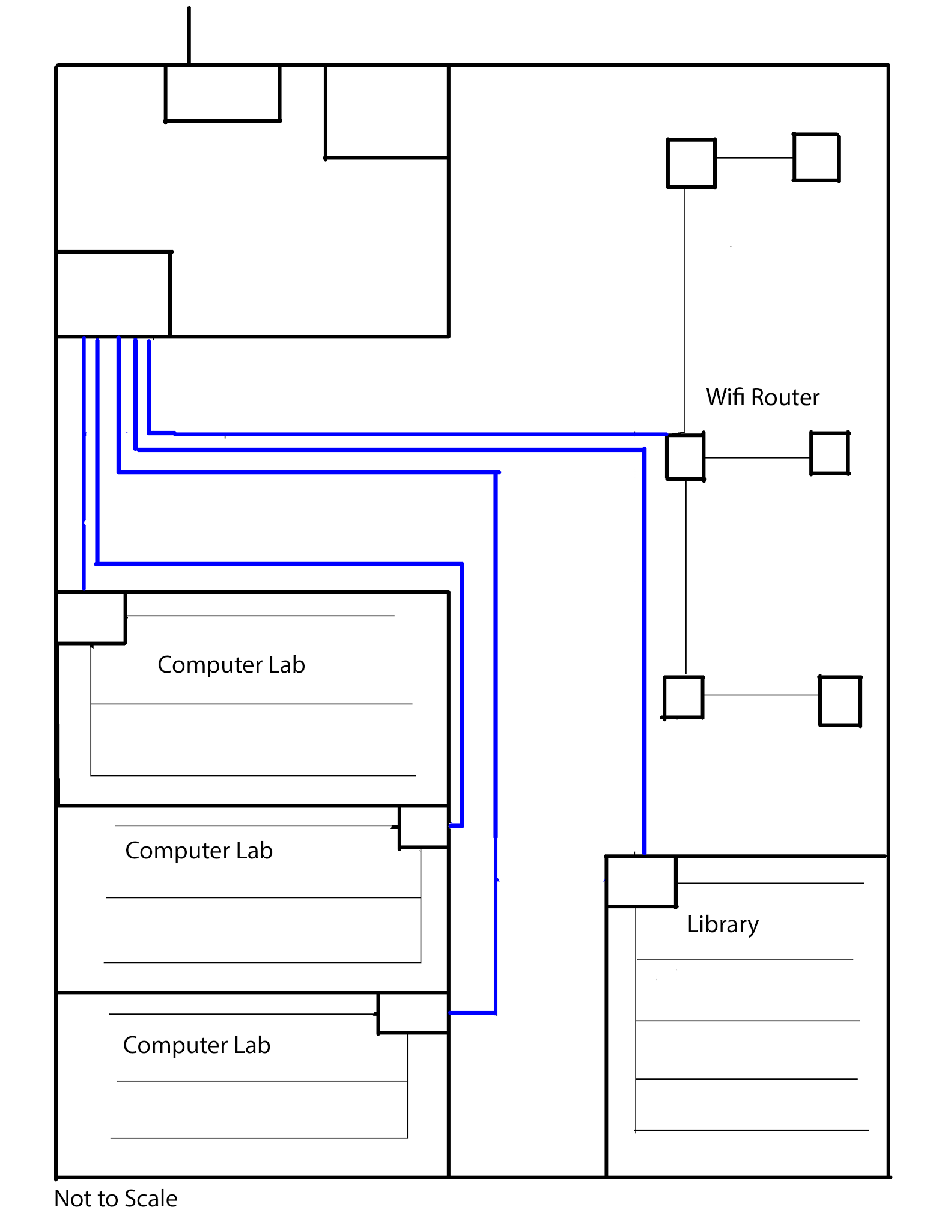
School District Network
Copper and Wireless
Faculty login required to access wifi
Admin building stores all user info and updates servers in each building
Wifi restrictions exist to minimize traffic
All wireless devices are registered with IT department for MAC address filtering.

Slide 10
School District Network
Users and Devices
High School
1 Dell PowerEdge R420 for local software storage
1 Juniper EX4500 switch for the access port
Juniper EX2200 switches in each computer lab (3 total)
1 Juniper EX2200 and 5 NetGear FS108 switches in library
3 computer labs, 25 computers per lab
50 teachers + 10 admin = 60 faculty computers
2 printers in library + 2 in teacher’s lounge + 1 per computer lab
10 tablets for admin
Notes:
the poweredge R420 is a server that can be used to store software files on site so that there’s no extra traffic from students trying to start up large software thats located in the admin building

Slide 11
School District Network
Users and Devices
Middle Schools
1 Juniper EX3200 switch for the access port
Juniper EX2200 switches in each computer lab (2 total)
1 Juniper EX2200 and 2 NetGear FS108 switches in library
2 computer labs, 25 computers per lab
40 teachers + 8 admin = 48 faculty computers
2 printers in library + 2 in teachers lounge + 1 per computer lab
8 tablets for admin

Slide 12
School District Network
Users and Devices
Elementary Schools
1 Juniper EX3200 switch for the access port
1 Juniper EX2200 switch in the computer lab
1 Juniper EX2200 switch in the library
1 computer lab, 25 computers per lab
15 teachers + 3 Admin = 18 faculty computers
2 printers in library + 2 in teachers lounge + 1 per computer lab
8 tablets for admin

Slide 13
School District Network
Users and Devices
Administration Building
1 Juniper EX4500 switch for the access port
1 Cisco Meraki MX600 for the firewall
3 Dell PowerEdge R420 for hosting services
1 Dell PowerVault MD1220 for storing student and employee records and as extra storage space
1 Dell PowerEdge R420 as a video server
16 admin + 6 IT = 22 laptops
1 printer

Slide 14
School District Network
Users and Devices
Networked devices
Cameras
Keycard access
Clocks
PA system
Lunch registers
Hosted services
Video surveillance
Firewall
Windows Pro
Print services
Puppet
User records storage

Slide 15
School District Network
Internal Traffic
High School
Video streaming (480p video data rate range)
2000/1000/500 kbps (top/recommended/minimum)
75 computers in lab + 60 Faculty + 25 in Library
Printing
minimal bandwidth required
Cameras
Minimum frame rate to decrease bandwidth
5 megapixel H.264 at 1 FPS = 30.47 Mbps
Source: http://www.supercircuits.com/resources/tools/network-ip-security-camera-system-bandwidth-calculator

Slide 16
School District Network
Ways to cut down traffic
Set up video server in admin building
Use redundants line with gigabit bandwidth to stream videos on server
Set up scheduled computer lab hours at each school prevent all resources from being used at once.
Example
Lab 1: 9:00 - 10:00 am, 11:00 am - 12:00 pm, etc.
Lab 2: 10:00 - 11:00 am, etc.
Security camera recordings are stored at each school and backed up to the admin building during off hours

Slide 17
School District Network
Future Expansions
Firewall can support double the current number of students
Video servers will limit the bandwidth needed for video streaming
Only 60% of ports are being used on each switch
With excess bandwidth, we may consider installing more access points that allow students to get on wifi

Slide 18
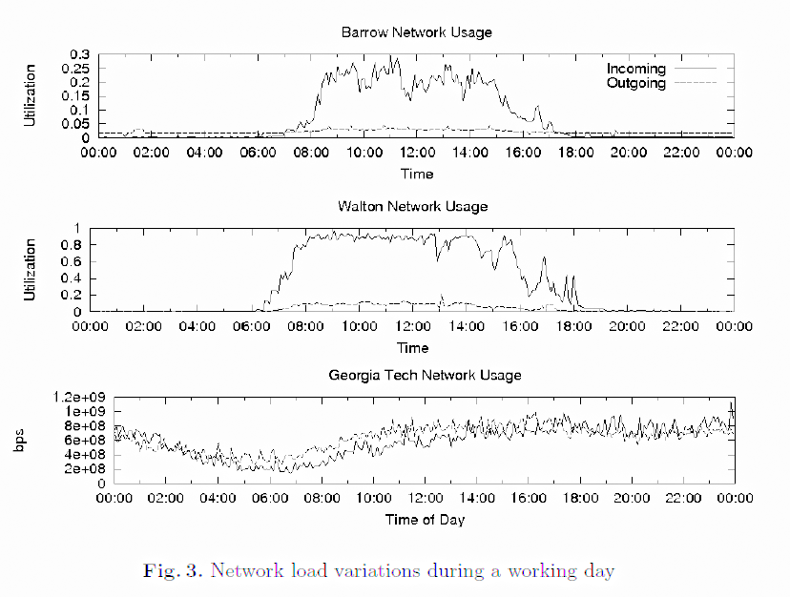
School District Network
Daily Traffic Patterns
Source: “Internet usage at elementary, middle and high schools: A first look at K-12 traffic from two US Georgia counties.“
by Robert Miller, Warren Matthews, and Constantine Dovrolis

Slide 19
School District Network
External Traffic
School | Estimated Usage (Moderate)
High School | 454 - 479 Mbps
Middle School | 363 - 383 Mbps
Elementary School | 136 - 161 Mbps
Source: http://bandwidthpool.com/bandwidth-calculator/

Slide 20
School District Network
External Traffic
Fiber Service
Provided by Conterra Broadband Services
70% funded by Federal Universal Service E-Rate program
Up to 1 Gbps to each building

Slide 21
School District Network
Cost of Acquisition (Network)
Item | Quantity | Cost
Fiber Installation | - | $39,900 total
Single Mode 9/125 OS2 fiber | 13.3 miles | $3,000 / mile
Network switches | - | $38,000 total
Juniper EX4500 | 2 | $7,500 each
Juniper EX3200 | 8 | $1,500 each
Juniper EX2200 | 22 | $500 each
NetGear RS108 | 9 | $40 each
Servers and storage | - | $9,600 total
Dell PowerEdge R420 | 5 | $1000 each
Dell PowerVault MD1220 | 1 | $4000 each
StarTech 25U cabinet rack | 2 | $300 each
Cisco Meraki MX600 | 1 | $0 (renting)

Slide 22
School District Network
Cost of Acquisition (Desktop)
Item | Quantity | Price
HP desktop, monitor, and keyboard | 351 | $500 each
Brother MFC-9130CW printer | 16 | $400 each
Lorex surveillance camera | 100 | $32.50 each
HP EliteBook Laptops | 22 | $2000 each
iPads | 26 | $500 each
Total |  | $242,150

Slide 23
School District Network
Annual Operating Cost
Service | Cost
IT staff (salary and benefits) | $432,000
Fiber | $66,697
Cloud (includes web hosting) | $3,828
Firewall support | $16,000
Total | $518,525
Source: http://swz.salary.com/MyBenefits/LayoutScripts/Mbfl_Start.aspx

Slide 24
Questions?

